Slide 1
COMP 51 Week Ten
Structures

Slide 2
Learning Objectives
Structures
Structure types
Structures as function arguments
Initializing structures
File I/O with Structures

Slide 3
Why Do We Care
Group logical data elements together
Base understanding for classes and objects → Object Oriented programming
Intro to COMP 53

Slide 4
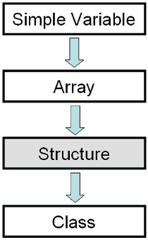
Structures
2nd aggregate data type: struct
Recall: aggregate meaning "grouping"
Recall array: collection of values of same type
Structure: collection of values of different types
Notes:
A simple variable identifier can hold a single data element of any data type. Arrays can hold a grouping of related data items of the same data type using a single identifier. Structures allow you to group data items of different data types under the same identifier. Classes build on Structures by hiding the data and adding the ability to include member functions.

Slide 5
Structure Definition
Must define struct before use
Typically at global level
So what does this mean? ____________
No memory is allocated
Just a "placeholder" for what our struct will "look like"
Example: struct CDAccountV1 ←Name of new struct "type" { double balance; ← member names double interestRate; int term; };

Slide 6
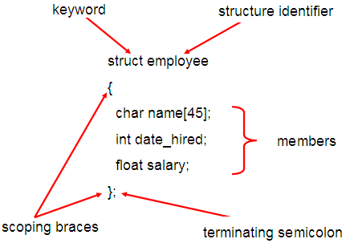
Structure Details
This is not the variable name . This represents a new data type

Slide 7
Structure Definition Practice
Write the structure definition that will hold a baseball player’s stats
Want to be able to track their name, batting percentage, number of home runs, triples, doubles, stolen bases, and on base percentage

Slide 8
Structure Definition Pitfall
Semicolon after structure definition
; MUST exist: struct WeatherData { double temperature; double windVelocity; }; ← REQUIRED semicolon!
Required since you "can" declare structure variables in this location

Slide 9
Working with Structure Variables
Declaring Structures
Just like declaring simple types
The new variable contains "member values"
CDAccountV1 account;
Dot Operator to access members
account.balance
account.interestRate
account.term
Account2.balance
Variable account now of type CDAccountV1 with all of the parts
Called "member variables“. Different structs can have same members

Slide 10
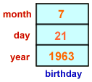
Initializing Structures
Can initialize at declaration
Example: struct Date { int month; int day; int year; }; Date birthDate = {7, 21, 1963};
Declaration provides initial data to all three member variables

Slide 11
Nested Structures
A structure definition can contain members that are other structures.
Example
typedef struct date { int month; int day; int year; }; typedef struct student {
char name[64];
char course[128];
date dob;
int age;
int year;
};
Student
dob
Dob is of data type date which is a structure

Slide 12
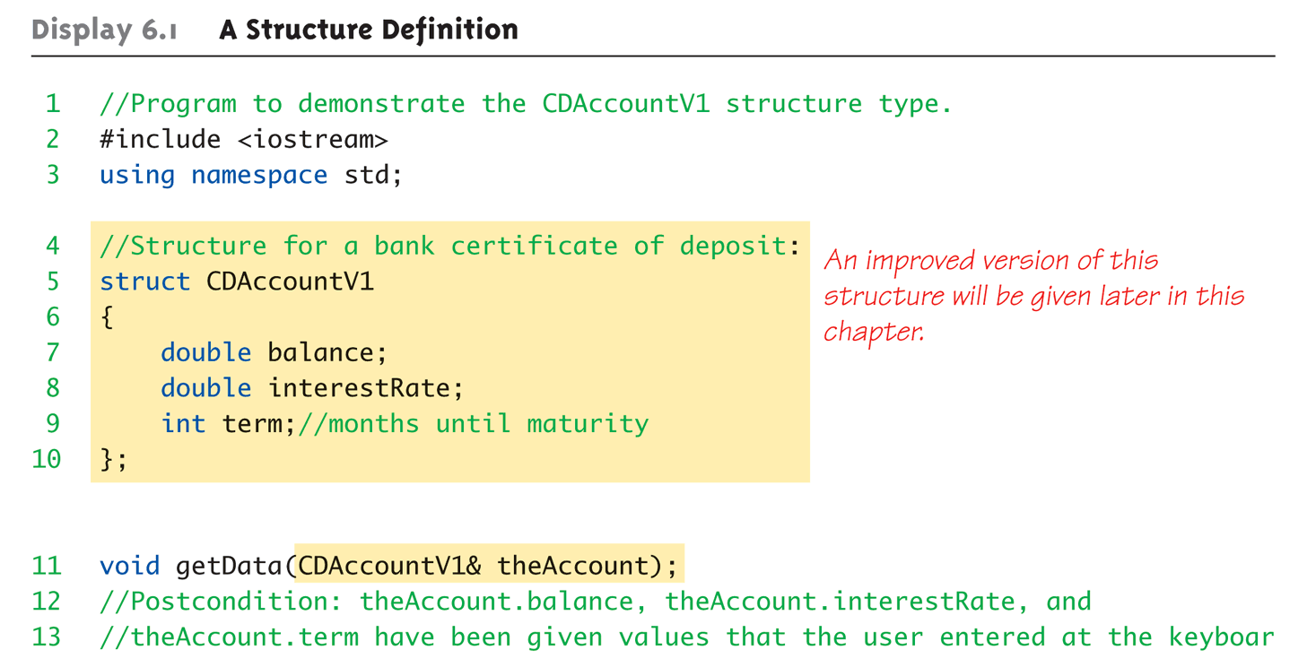
Structure Definition Example Part 1 of 3

Slide 13
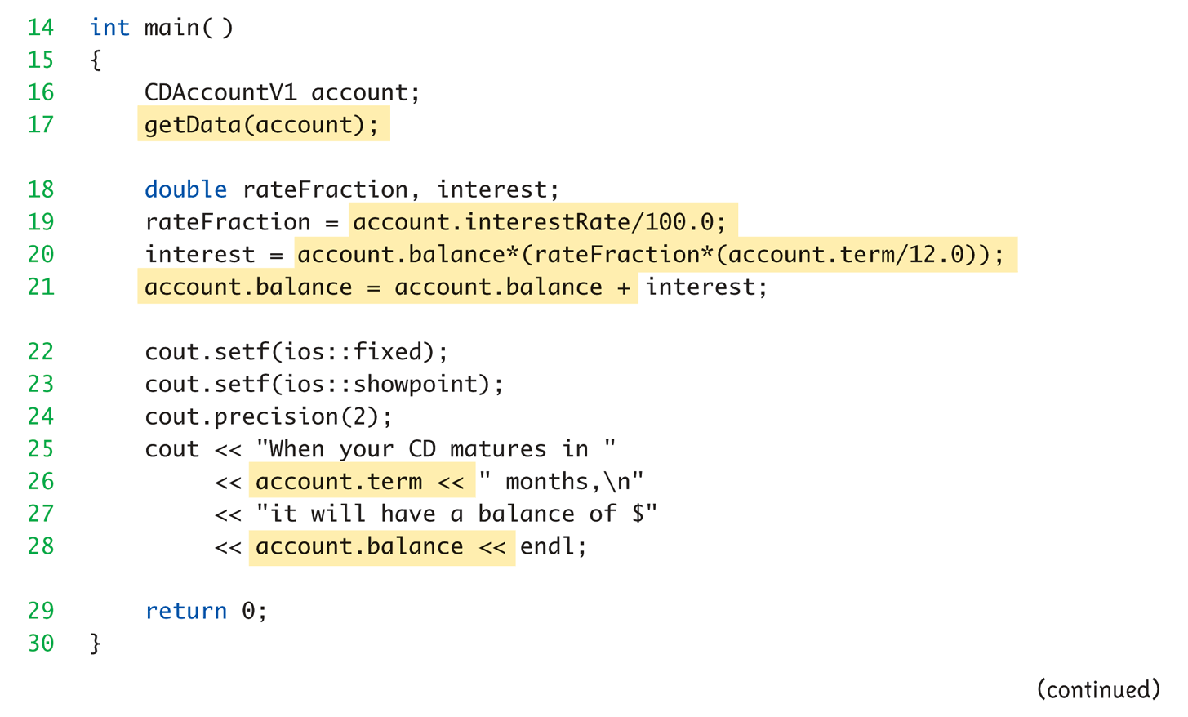
Structure Data Access Example Part 2 of 3

Slide 14
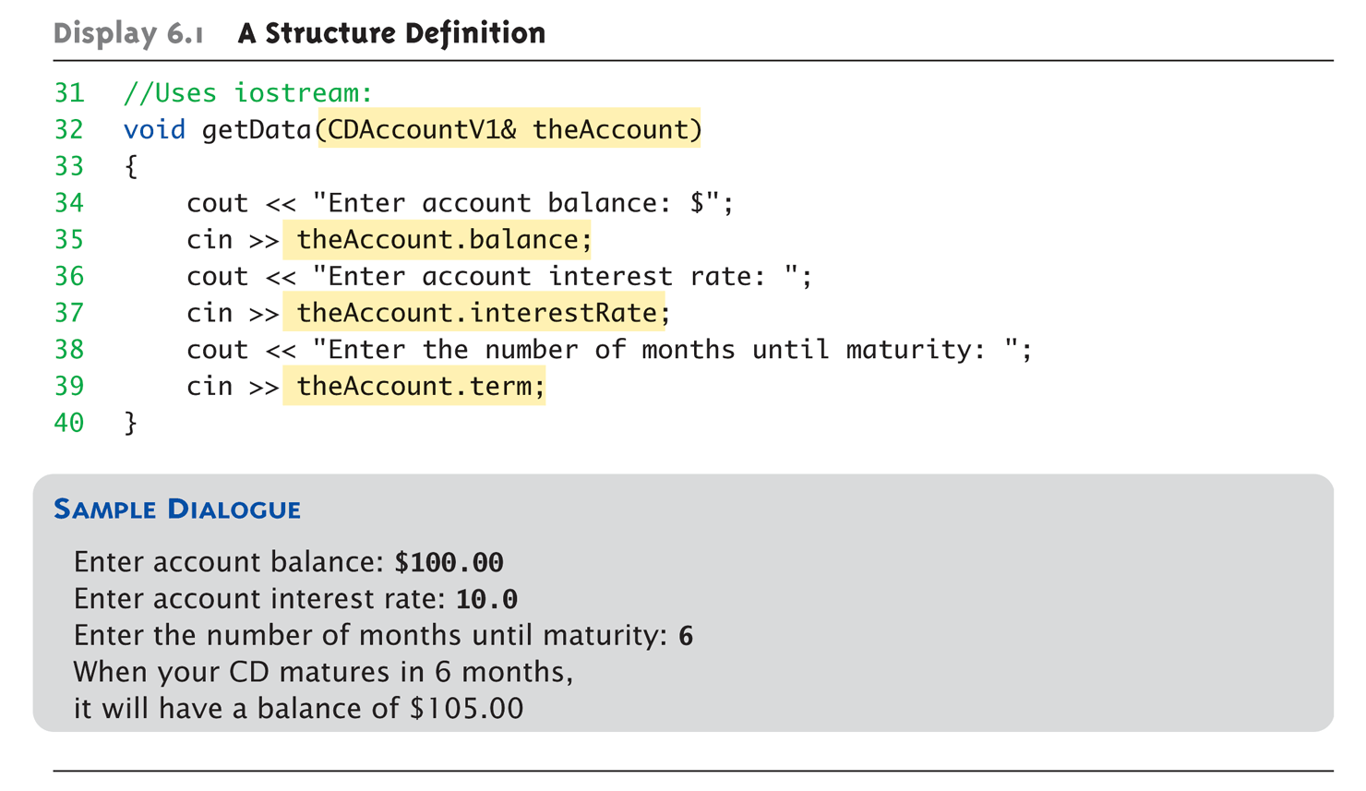
Structure Parameter Example Part 3 of 3
What does the ‘&’ mean???

Slide 15
Structure Assignments
Given structure named CropYield
Declare two structure variables: CropYield apples, oranges;
Both are variables of "struct type CropYield"
Simple assignments are legal: apples = oranges;
Simply copies each member variable from apples into member variables from oranges

Slide 16
Structures as Function Arguments
Passed like any simple data type
Pass-by-value
Pass-by-reference
Can also be returned by function
Return-type is structure type
Return statement in function definition sends structure variable back to caller

Slide 17
Arrays of Structures
Each element of the array can be a structure definition
C++ allocates memory = number of elements * sizeof(structure definition)
Definition
employee misGroup[10];
Assignment
misGroup[0].name = “Mike”;
misGroup[0].salary = 45000.00

Slide 18
Structure Practice Inventory Value Continued
Define a structure that maps to last week’s input file and output file formats
Declare a variable for the structure to hold the inventory data.
Update your program to save the inStream data to the structure
Update the outStream statement to print out the computed inventory value
If time, identify the item that has the largest value in stock (save this to a different variable)

Slide 19
Key Takeaways
A structure is a new data type
You control the contents
Made up of simple data types, arrays, and other structures
Use “dot” notation to reference members.
Structures can be passed to and from functions
What’s the recommended parameter passing mode? ________

